Slide 1

Big Data
Guided By- Ms. Swati Jadhav
Presented By- Manasi Patil
Chaitanya Patil
Uma Thakur
Bhavin Patil

Slide 2
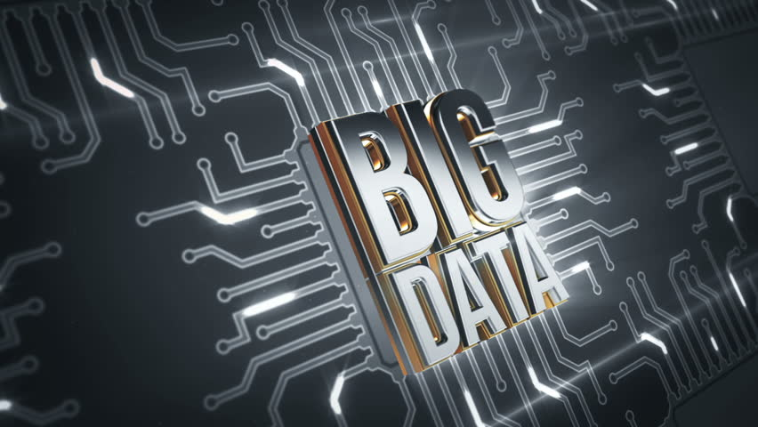
Table of Content
What is Data Structure
Big Data Sources
Characteristic of Big Data
Big Data Application Areas
Big Data Technology Areas
Types of Big Data
Benefits of Big Data
Impact of Big Data
Big Data Opportunities
Big Data Cons
Conclusion

Slide 3
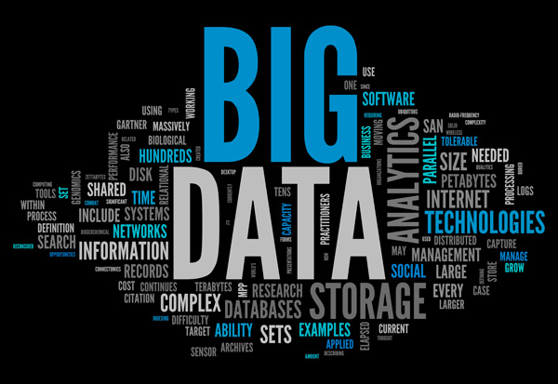
Big data is the term for a collection of data sets so large and complex that it becomes difficult to process using on-hand database management tools or traditional data processing applications.
Data that contains
greater variety
arriving in increasing volumes
more velocity.
Big data is larger, more complex data sets, especially from new data sources
What is big data ?

Slide 4





Big Data Sources
Media
Web
Social influencers
Big data sources
Cloud
Social network profiles
Internet of things

Slide 5

Big Data Sources
Twitter users send out 285,000
Tweets
06
01
Google processes more than 2 MILLION Search queries
Facebook processes almost 350GB
of data
More than 100 MILLION New emails are generated
05
02
data Individuals and organizations launch 576 New websites
72 HOURS of new video are uploaded to you tube
04
03

Slide 6
Characteristics of Big Data
Extract useful data
Huge amount of Data
Value
Volume
Big data
Inconsistencies and uncertainty in data
veracity
Velocity
High speed of accumulation of data
Variety
Different formats of data from different sources

Slide 7







Big data Application Areas
Government
Healthcare & research
Finance and banking
Education
Retail
Mobile telecom

Slide 8







Big data Technology Areas
Time series
Machine learning
Natural language processing
Data integration
Big data
Signal processing
Crowd sourcing
Simulation
Data fusion

Slide 9


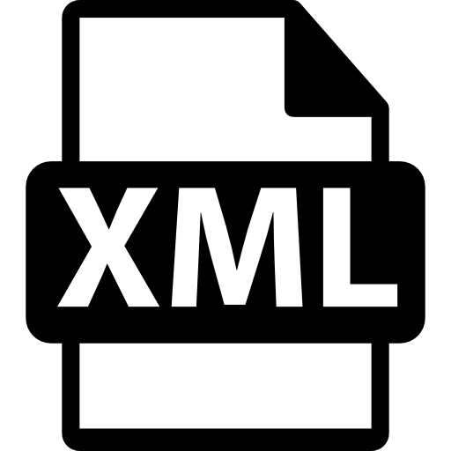




Types of Big Data
Unstructured
Structured
Semi-structured
Clouding
Analog data
XML
Data bases
GPS
Email
Enterprise systems
Video/audio streams
EDI
Data that does not have defined length and format for big data
Data that has a defined length and format for big data
Combination of both structured and unstructured data

Slide 10




Benefits of Big Data
30%
50%
70%
90%
Increased efficiency
Better business decision making
Improve customer experience and engagement
Achieved financial savings

Slide 11




Impact of Big Data
Health care
Security
Identify and promptly intervene on high-risk and high-cost patients
Threat Visualization
Science
Business
Derive useful insights through a predictive analysis
Help companies store large volumes of data

Slide 12
Big Data Opportunities
Enhanced information management
Increased operations efficiency and maintenance
Increased supply chain visibility and transparency
Greater responsiveness
Enhanced product and market strategy
Improved demand management and production planning
Big data opportunities

Slide 13
Big Data Cons
Cost and Infrastructure Issues
Questionable Data Quality
Cons
Compliance Headaches
Heightened Security Risks
Big Data Skills Shortage

Slide 14
Conclusion
Big Data is a game-changer. Many organizations are using more analytics to drive strategic actions and offer a better customer experience. A slight change in the efficiency or smallest savings can lead to a huge profit, which is why most organizations are moving towards big data.

Slide 15

Thank you

